Slide 1
SaaSy maps - Using django-tenants and Geodjango to provide web-GIS Software-as-a-Service
Anusha Chickermane

Slide 2
Objectives
create a semi-isolated multi-tenant architecture using django-tenants+postgresql
build on top of it using geodjango+postgis+openlayers to provide individualised web mapping services to different clients
performance and security implications of this approach
We achieve this by creating a website that shows accident point locations for three different counties and brings up the associated attributes of date_of_accident and number_of_vehicles
Code and this presentation at https://github.com/anushamc/foss4guk-django-tenants

Slide 3
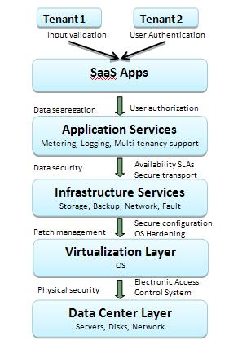
Software As A Service
SaaS - software deployment model where applications are remotely hosted by the service provider and made available to customers on demand
Eg. github.io, has multiple tenants
tombatossals.github.io/angular-openlayers-directive/ – user tombatossals example page
blueimp.github.io/jQuery-File-Upload/ - user bluimp’s example page
We look at the top 2 layers of the SaaS architecture – Saas apps and Application services
Notes:
Image from http://www.infosectoday.com/Articles/Securing_SaaS_Applications.htm

Slide 4
Saas Security concerns
SaaS deployment model – Aws or self-hosted?
Data security(encryption, app vulnerability) – Django+postgres
Network security (SSL) – Django
Regulatory compliance
Data segregation – tenant-schemas
Availability
Backup
Identity management and sign-on process - Django

Slide 5

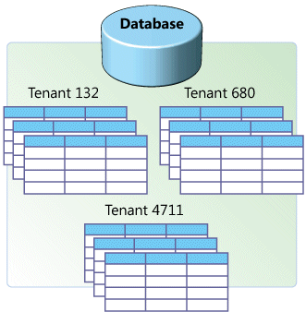
Data Segration
django-tenants lies in the middle: shared database, separate schemas
Isolated – more secure, but costlier to implement and maintain, and lower performance
Shared – less secure, but easier to implement and better performance
The right choice on the spectrum depends on business requirements and sensitivity of the data

Slide 6
Performance
Not as memory intensive as having separate databases
As the number of schemas (i.e. tenants) grows, propagating model (i.e. database structure)changes will take longer – parallel migrations help reduce this performance hit
Since the same database models are used across tenants, customisation of each tenant is limited to only changing the look & feel via templates – i.e cant have one geometry field for one tenant and two for another in the same model
If using main-domain and subdomain, eg github.io and bluimp.github.io, need to watch out for cookie attacks across subdomains
Notes:
Cookie attacks - https://github.com/blog/1466-yummy-cookies-across-domains

Slide 7
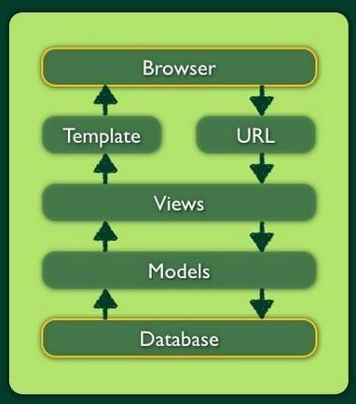
The Django Framework
MVT – Model View Template
Model – defines the data structure and handles the database queries
View – determines what data from the model should be returned in HTTP response
Template – renders data in HTML(or JSON or XML) and makes it look pretty
Notes:
Image from - http://brionas.github.io/2013/11/15/share-django/

Slide 8
A Typical Django Project
mysite/
manage.py
mysite/
settings.py
urls.py
wsgi.py
app/
admin.py
migrations/
models.py
static/
css/
js/
templates/
Index.html
tests.py
views.py
manage.py – runserver, makemigrations, migrate
settings.py – database and site settings
urls.py – urls mapped to views
admin – to create the admin interface
Models – define the database structure
Templates – html files with Django tags
Views – handle get and post requests
Notes:
Structure based on https://docs.djangoproject.com/en/1.9/intro/tutorial01/

Slide 9
Django-Tenants app
mysite/
manage.py
mysite/
settings.py
…
public_app/
admin.py
migrations/
…
tenant_app/
admin.py
migrations/
…
public_app – accessed from the main domain i.e. www.mainsite.com
tenant_app – accessed from the tenant’s sub-domain

Slide 10
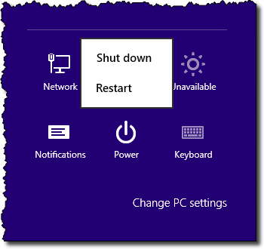
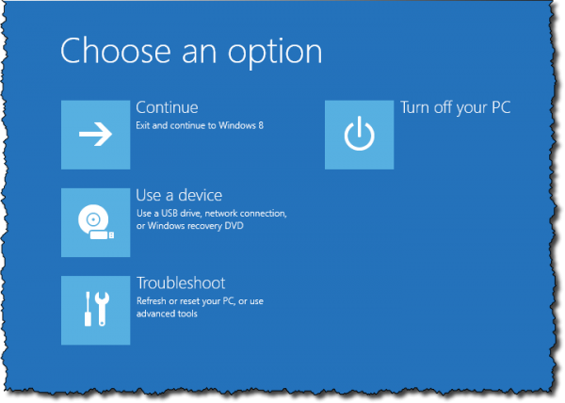
Setup
Boot from OS-Geo-Live
Insert disk into CD drive, restart system and hold down F12 to access boot options
For windows 8 and above – Click on the power option (either on the Start Screen or the Charms Bar) and then hold down the shift key while clicking on Restart.

Slide 11
Modifying the hosts file to simulate different tenants
Open the terminal and run the following command:
sudo vim /etc/hosts
Near the top of the file, add the following lines:
127.0.0.1 mainsite.com
127.0.0.1 cumbria.mainsite.com
127.0.0.1 lancashire.mainsite.com
127.0.0.1 london.mainsite.com
To exit the editor, press ESC and then type :wq

Slide 12
Creating the database
Open pgAdmin III.
Create a new database called ‘multi_county_db’.
Add the postgis extension.
Notes:
Right click Databases to create a new database
Open Plugins>PostGIS Shapefile Import/Export Manager

Slide 13
Installing Django, Geodjango and Django-tenants
Open the terminal and run
Install pip and django:
sudo apt-get install python3-pip
sudo pip3 install django
Install python bindings for postgres:
sudo apt-get install python3-psycopg2
Install Django-tenants:
sudo pip3 install django-tenants

Slide 14
Creating the Project
Open the terminal and run
Create the project
django-admin startproject multi_county
Open the project and create apps
cd multi_county
python3 manage.py startapp public_app
python3 manage.py startapp tenant_app
Replace contents of multi_county\settings.py with https://raw.githubusercontent.com/anushamc/foss4guk-django-tenants/master/multi_county/multi_county/settings.py
Replace contents of public_app\models.py with https://raw.githubusercontent.com/anushamc/foss4guk-django-tenants/master/multi_county/public_app/models.py

Slide 15
Creating the Project
Open the terminal and run
python3 manage.py migrate_schemas –-shared
Replace contents of tenant_app\models.py with https://github.com/anushamc/foss4guk-django-tenants/blob/master/multi_county/tenant_app/models.py
Open the terminal and run
python3 manage.py makemigrations
python3 manage.py migrate_schemas

Slide 16
Creating the tenants********
In the same folder as manage.py, download the file create_tenants.py from
Open the terminal and run
python3 manage.py shell < create_tenants.py

Slide 17
Importing the data
Download the data for the schemas from https://github.com/anushamc/foss4guk-django-tenants/tree/master/data
Go to PG Admin III and expand the schemas Lancashire, cumbria and london
Right-click the tenant_app_accident table for each county schema, and select Import…
In File Options tab, change type to csv and choose the relevant csv file
In Columns uncheck id and geom
In Misc. Options check header
Click Import button
Do this for all 3 county schemas

Slide 18
Importing the data
From PG Admin III Run the following sql command on the database:
UPDATE antrim.tenant_app_accident SET geom=ST_GeomFromText('POINT(' || location_easting_osgr || ' ' || location_northing_osgr || ')',27700);
UPDATE lancashire.tenant_app_accident SET geom=ST_GeomFromText('POINT(' || location_easting_osgr || ' ' || location_northing_osgr || ')',27700);
UPDATE london.tenant_app_accident SET geom=ST_GeomFromText('POINT(' || location_easting_osgr || ' ' || location_northing_osgr || ')',27700);

Slide 19
Creating the Template
Create a new folder called static in tenant_app\ folder, and extract into it javascript-libraries.zip from https://github.com/anushamc/foss4guk-django-tenants/blob/master/javascript-libraries.zip?raw=true
Create a new folder called templates in tenant_app\ folder and place file index.html from https://raw.githubusercontent.com/anushamc/foss4guk-django-tenants/master/multi_county/tenant_app/templates/index.html
Create a new folder called js in tenant_app\static\ folder and place file accidents.js from https://raw.githubusercontent.com/anushamc/foss4guk-django-tenants/master/multi_county/tenant_app/static/js/accidents.js

Slide 20
Creating the Template
Create a new folder called css in tenant_app\static\ folder and place files themes.min.css and accidents.css from https://raw.githubusercontent.com/anushamc/foss4guk-django-tenants/master/multi_county/tenant_app/static/css/theme.min.css and https://raw.githubusercontent.com/anushamc/foss4guk-django-tenants/master/multi_county/tenant_app/static/css/accidents.css

Slide 21
Creating the View
Replace the contents of the tenant_app/views.py file with https://raw.githubusercontent.com/anushamc/foss4guk-django-tenants/master/multi_county/tenant_app/views.py
Replace the contents of the multi_county/urls.py file with https://raw.githubusercontent.com/anushamc/foss4guk-django-tenants/master/multi_county/multi_county/urls.py
Open the terminal and run
python3 manage.py runserver
Open mainsite.com:8000 to get an empty map, cumbria.mainsite.com:8000 to get the accidents points layer from Cumbia, london.mainsite.com:8000 to get London, and lancashire.mainsite.com:8000 to get the data from Lancaster

Slide 22
Thank you for your time!

